Slide 1

UNIVERSITY OF GHANA, LEGON (All rights reserved)
Design and Development of a Database Driven Web and Mobile Application
GROUP 2
MICHELLE OWUSU – 10957340
MENSAH NYANYO HUBERT - 10976127
ANANE GEORGE NYARKO - 10947340
DERY-KUUZUME SANDRA - 10986424
APPIAH YAW FRIMPONG - 10987818
BENTIL B. REXFORD – 10946257
EVANS ACHEAMPONG - 10987644

Slide 2


Introduction
Problem Statement: The objective of this project is to create a database-driven web and mobile application that caters to the needs of a School Educational Sciences (SES). The application will allow students to register, log in, provide their information, and access a personalized dashboard. The dashboard will display essential academic information, including courses, grades, and schedules, to help students manage their academic journey effectively.
Requirements:
Front End: The frontend of the application will be developed using React for the web version and Flutter for the mobile version. These frameworks offer rich user interface components and allow for cross-platform development.
Backend/Web Service: The backend and web service will be developed using Spring Boot. Spring Boot provides a robust foundation for building RESTful APIs that enable communication between the frontend and backend.
Database: PostgreSQL will be used as the database management system. Its relational model is well-suited for handling structured data, essential for an educational application.

Slide 3

Software Process
Iterative and Incremental Development: The project will follow an iterative and incremental development process to accommodate changing requirements and implement new features incrementally.
Agile Methodology: The Agile approach will be adopted for the development process. It allows for continuous feedback, collaboration, and adaptability throughout the development lifecycle. Scrum will be used as the Agile framework for this project, with sprint planning, reviews, and retrospectives.

Slide 4

Software Modelling
Entity-Relationship Diagram (ERD): An ERD will be used to model the database structure. It will define entities such as students, courses, grades, and their relationships. The ERD acts as a blueprint for designing the database schema.

Slide 5

Software System Architecture
Three-Tier Architecture: The application will follow a three-tier architecture, comprising the presentation layer (frontend), application logic layer (backend), and data storage layer (database).
Presentation Tier (Frontend): React will be used for the web version, delivering an interactive and responsive user interface. Flutter will be utilized for the mobile version to provide a seamless cross-platform experience.
Application Tier (Backend/Web Service): Spring Boot will handle the application's logic and serve as the web service. It will process HTTP requests from the frontend, apply business logic, and interact with the database for data retrieval and manipulation.
Data Tier (Database): PostgreSQL will be the data storage layer, efficiently managing data persistence and providing support for complex queries.

Slide 6

Design and Implementation
Frontend: React and Flutter will be used to design and implement user interfaces for the web and mobile versions, respectively. React components and state management will handle frontend interactions, while Flutter widgets and stateful/stateless classes will manage mobile app interactions.
Backend: Spring Boot will be used to design and implement the server-side logic. It will handle HTTP requests from the frontend, process business logic, and interact with the PostgreSQL database using JPA (Java Persistence API).
Database: PostgreSQL will store and manage the application's data. SQL queries will be used to interact with the database and perform CRUD (Create, Read, Update, Delete) operations.

Slide 7

Testing
Integration Testing: Integration tests will verify interactions and compatibility between different components and modules. It will ensure seamless communication between the frontend, backend, and database layers.
User Acceptance Testing: End users will perform user acceptance testing to ensure that the application meets their requirements and expectations before deployment.
Performance Testing: The application's performance will be evaluated to identify and optimize any bottlenecks or performance issues.

Slide 8

Software Project Management
Planning: The project will be planned with defined objectives, scope, timeline, and resource allocation. Project managers will create a Work Breakdown Structure (WBS) to organize and manage tasks efficiently.
Costing: The cost of the project, including development resources, infrastructure, and potential third-party services, will be estimated and managed throughout the project lifecycle.
Scheduling: A detailed project schedule will be created, outlining the sequence of activities and their timelines. Gantt charts or Agile boards will be used to track progress and manage deadlines.

Slide 9

End Product
Description of the Final Software System: The final software system will be a fully functional web and mobile application that allows students to register, log in, submit and view their information, and access a personalized dashboard with relevant academic data.
Features and Functionality: The application will include user authentication, student registration, information entry, and a dashboard with interactive components displaying courses, grades, and schedules.
Deployment Details: The application will be deployed on suitable hosting platforms for the web and mobile app versions. The PostgreSQL database will be hosted on a dedicated server or cloud service.

Slide 10

Application Screenshots
This section will showcase screenshots of the Flutter mobile application and the React web application developed for the project. Visual representations of the user interfaces will give the audience a glimpse of the final products.
Appendix A: Flutter Mobile Application Screenshots
Appendix B: React Web Application Screenshots

Slide 11
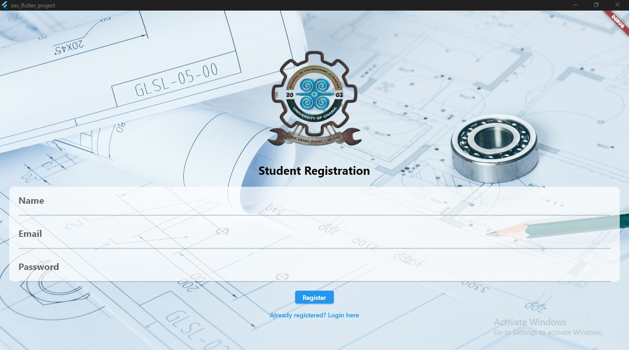
Flutter Mobile Application Screenshots: Registration Page

Slide 12
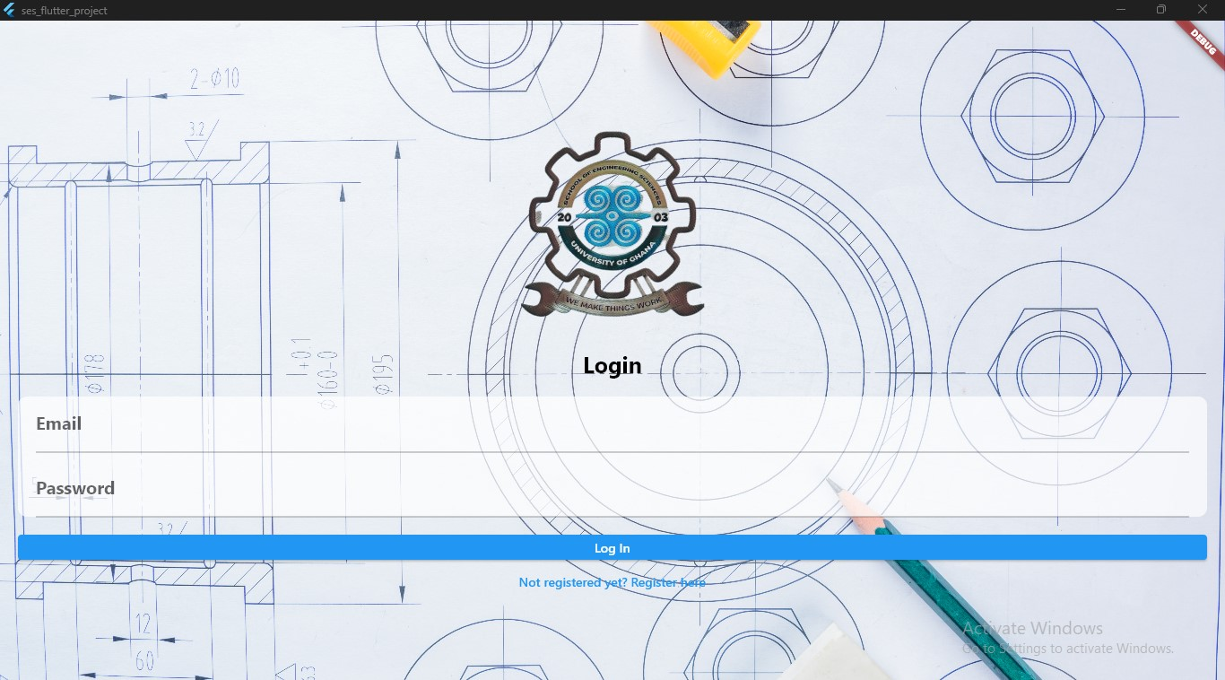
Flutter Mobile Application Screenshots: Login Page

Slide 13
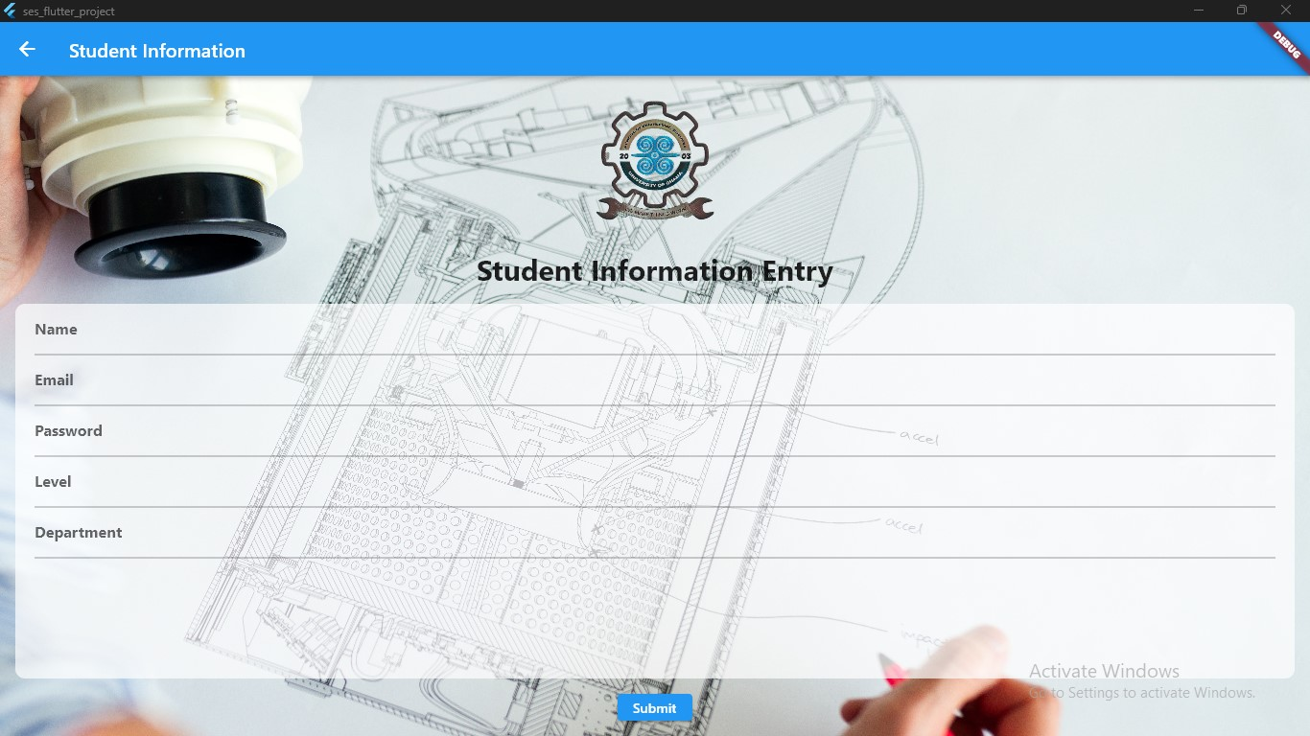
Flutter Mobile Application Screenshots: Info Entry Page

Slide 14
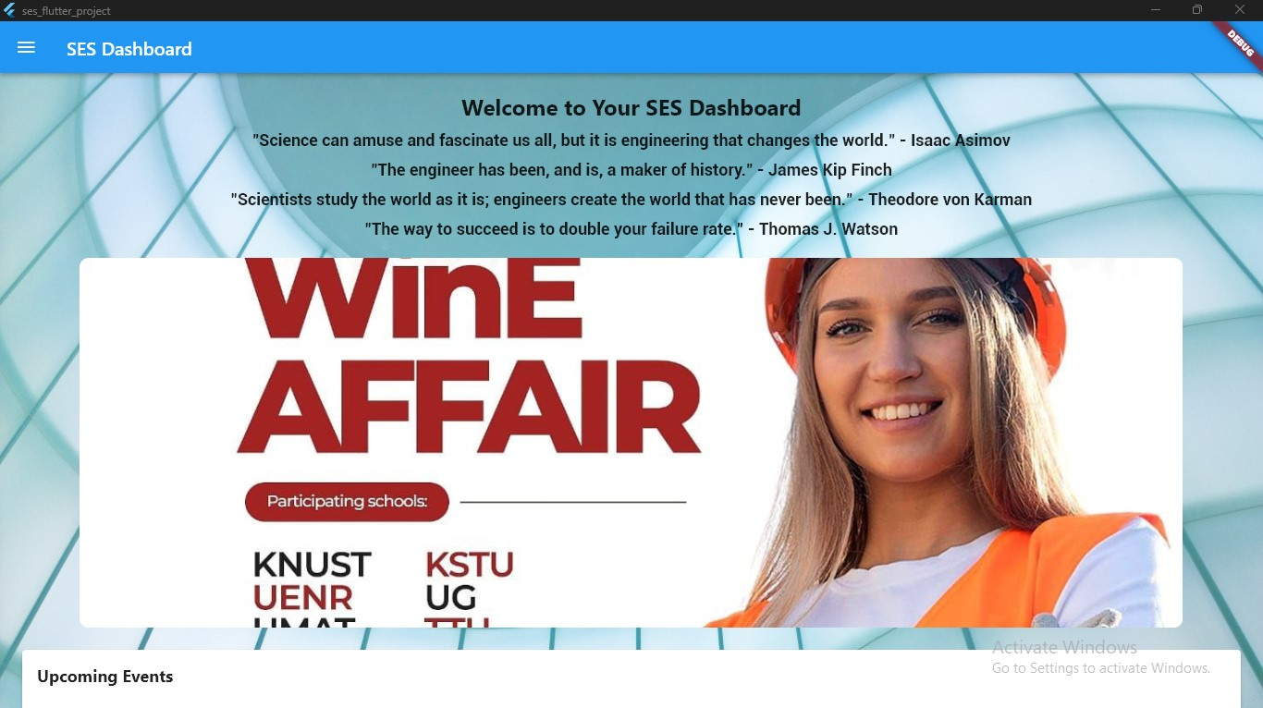
Flutter Mobile Application Screenshots: Dashboard

Slide 15
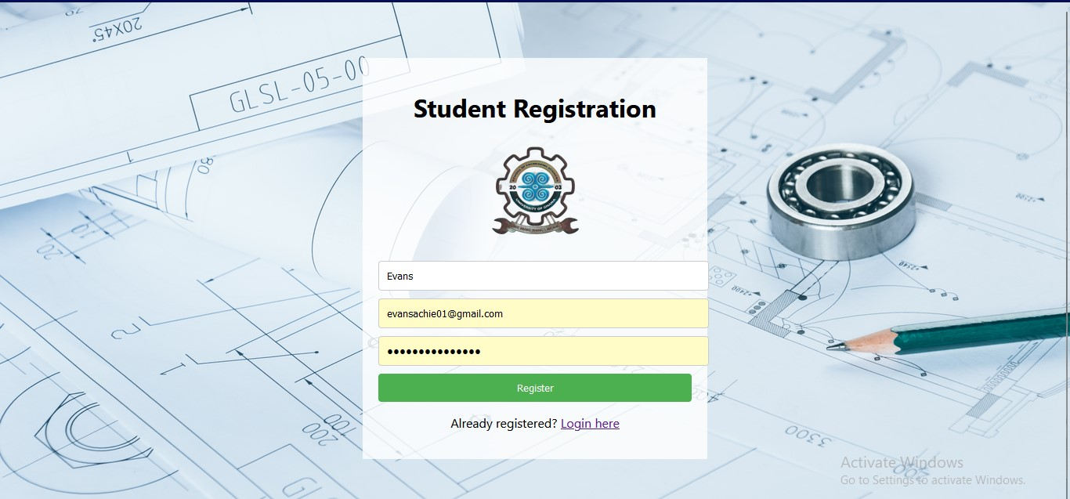
React Web Application Screenshots : Registration Page

Slide 16
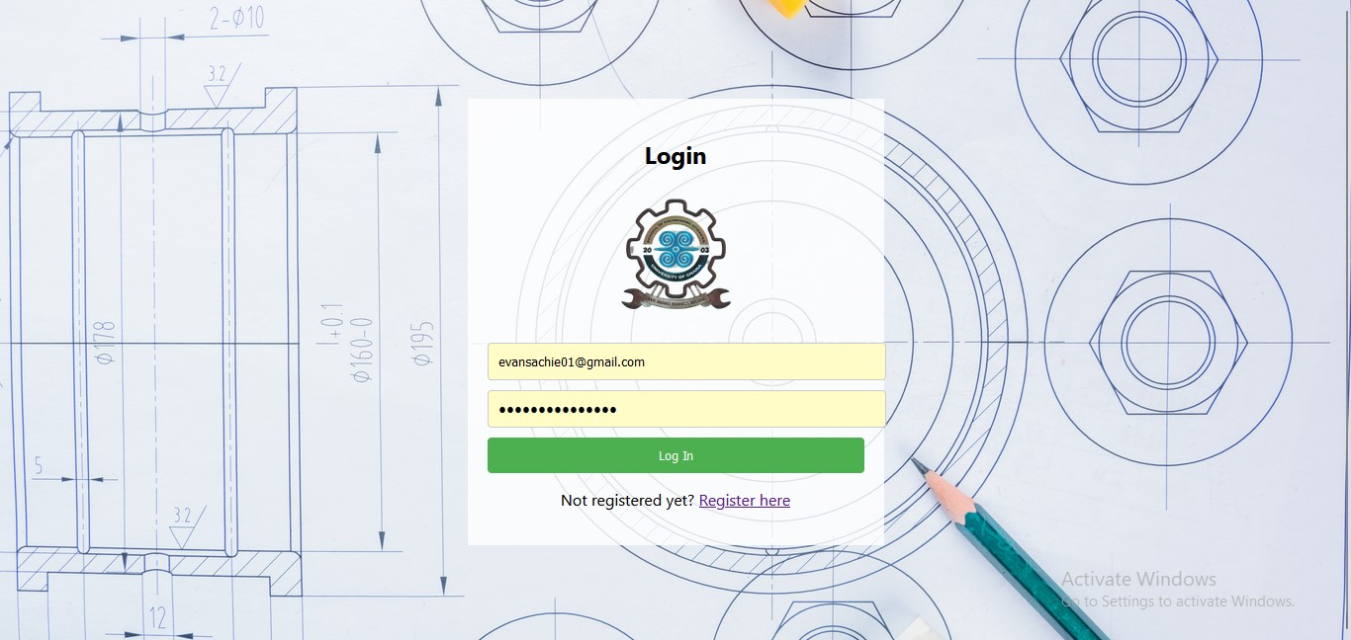
React Web Application Screenshots : Login Page

Slide 17
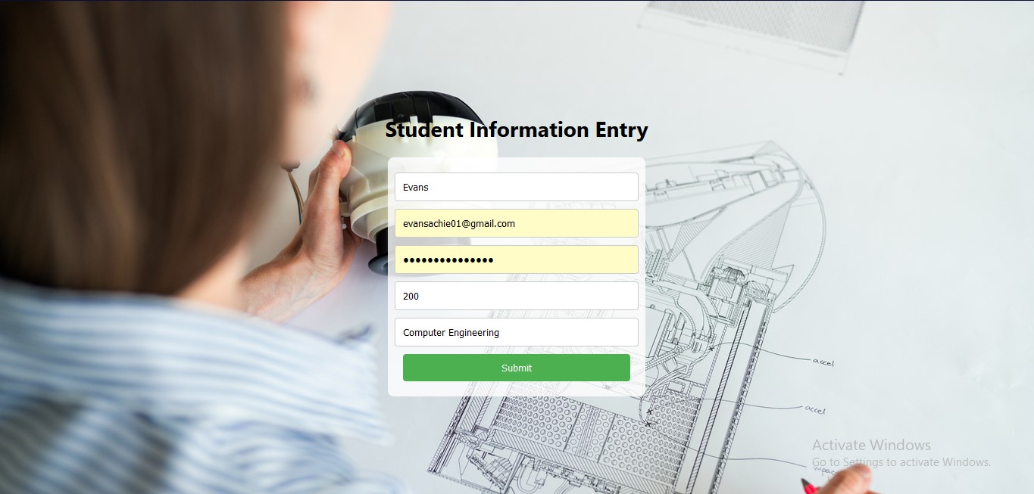
React Web Application Screenshots : Info Entry Page

Slide 18
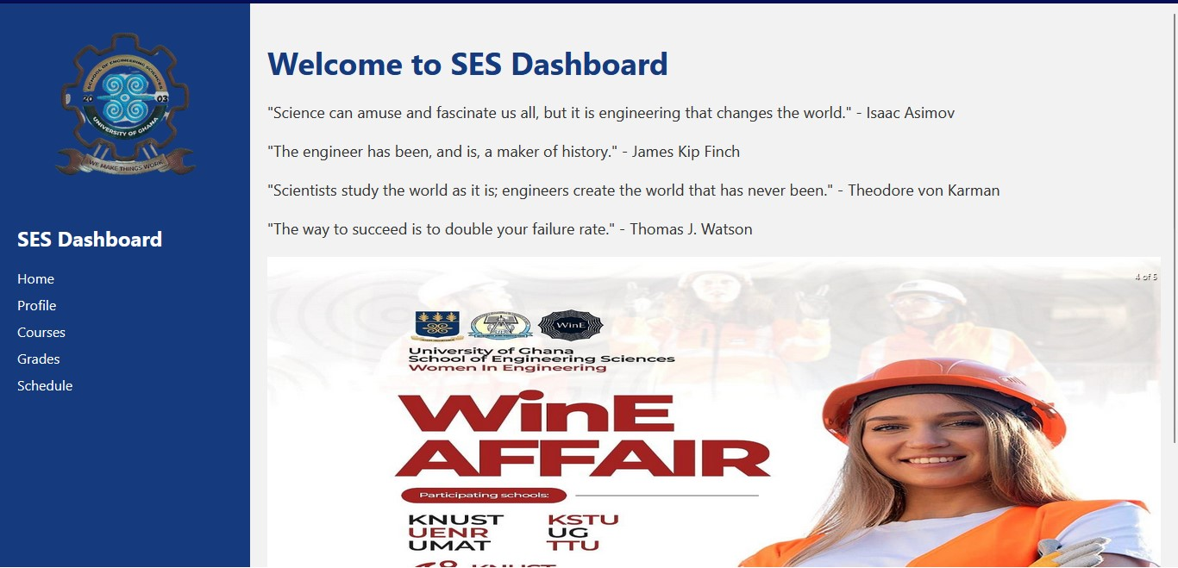
React Web Application Screenshots : Dashboard

Slide 19

Conclusion
Summary of the Project: The project successfully developed a database-driven web and mobile application for the School Educational System (SES). It provides a user-friendly interface, efficient data management, and a personalized dashboard for students to manage their academic journey effectively.
Future Enhancements: Possible areas for future enhancements, such as adding new features (e.g., messaging, notifications) or improving existing ones, will be identified for further development.

Slide 20





Question Time

Slide 21

Thank You

